Slide 1

CO2 Emission - Prediction Model Submitted in partial fulfilment of the Requirement for the Degree of Bachelor of Technology In Computer Science and Engineering Submitted BY Abhishek Gupta (1/16/FET/BCF/1/19) Shiv Shankar satapathy (1/16/ FET/BCF/1/025) Bimlender thakur (1/15/ FET/BCF/1/36) Bharat Singh (1/16/ FET/BCF/1/032) Under the supervision of Dr. BRIJESH KUMAR (PROF. & HOD) Mrs. POONAM TANWAR(ASSOCIATE PROF.) Dr. BRIJESH KUMAR (PROF. & HOD) Mrs. POONAM TANWAR(ASSOCIATE PROF.)
Department of Computer Science and Engineering
Faculty of Engineering & Technology
Manav Rachna International Institute of Research and Studies, Faridabad
FEB 2020

Slide 2
Overview
Climate change due to carbon dioxide (CO2) emissions is one of the most complex challenges threatening our planet. This issue considered as a great and international concern that primary attributed from different fossil fuels.
To reduce the effect of Global Warming caused mainly due to CO2 cars manufacturing companies are pre-estimating the CO2 emissions for a newly manufactured car that is about to launch in near future based on the features of car.
This project deals with estimating the CO2 Emissions for a newly manufactured car by making Regression models which can accurately predetermine the car CO2 emissions before it is being launched.

Slide 3
The Data given here is for Year 2014 manufactured Cars.
YEAR – Year of manufacturing of car.
- MAKE – Manufacturing company name.
- VEHICLECLASS – Type of vehicle like SUV or medium sized etc.
- ENGINESIZE – Size of the car’s engine (expressed in cc or cubic centimetre).
- CYLINDERS – Number of Cylinders in the engine.
- TRANSMISSION – Automatic or manual transmission with number of gears.
- FUELTYPE – It indicates the type of fuel car use i.e. Diesel, Petrol, Z (Unleaded Petrol) etc.
- FUELCONSUMPTION_CITY – Fuel consumption or Fuel economy of car while running in city expressed in miles per gallon.
- FUELCONSUMPTION_HWY - Fuel Consumption or Fuel economy of car on highway expressed in miles per gallon.
- FUELCONSUMPTION_COMB – Net or combination of Fuel Economy expressed in miles per gallon.

Slide 4
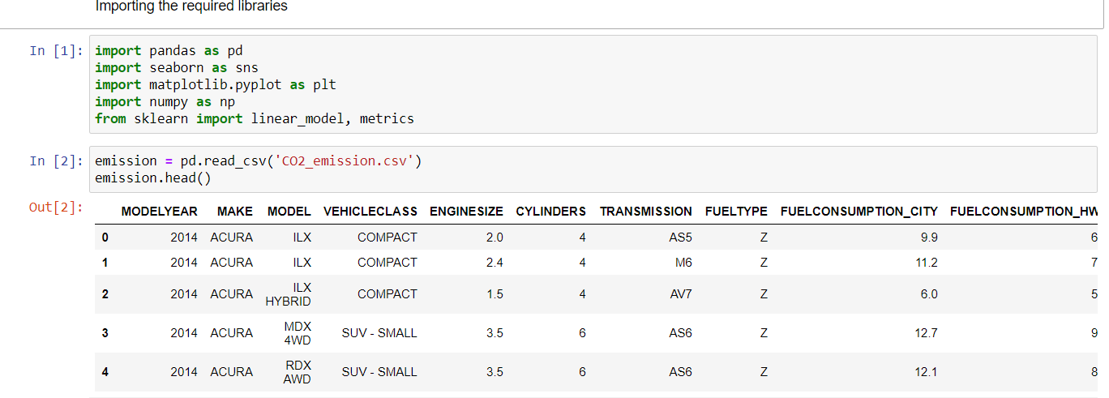
Task 1 – Loading the Data:

Slide 5
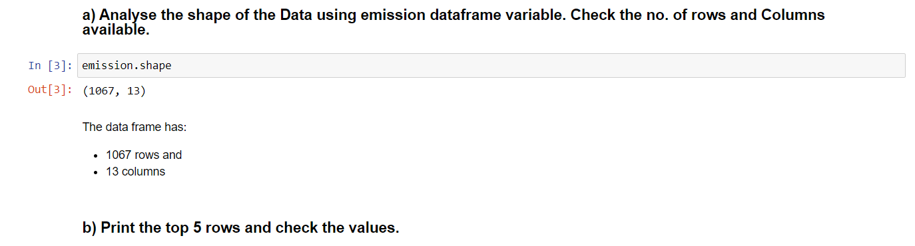
Task 2 - Analysing and cleaning data

Slide 6
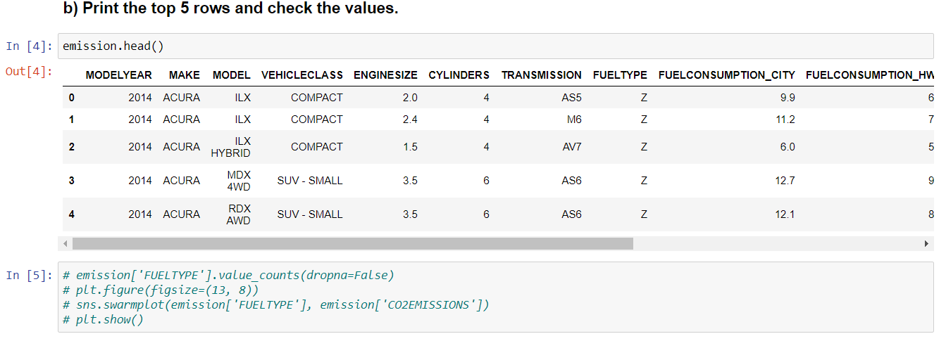

Slide 7
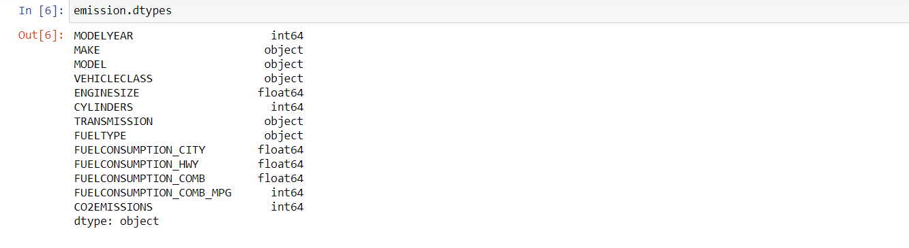
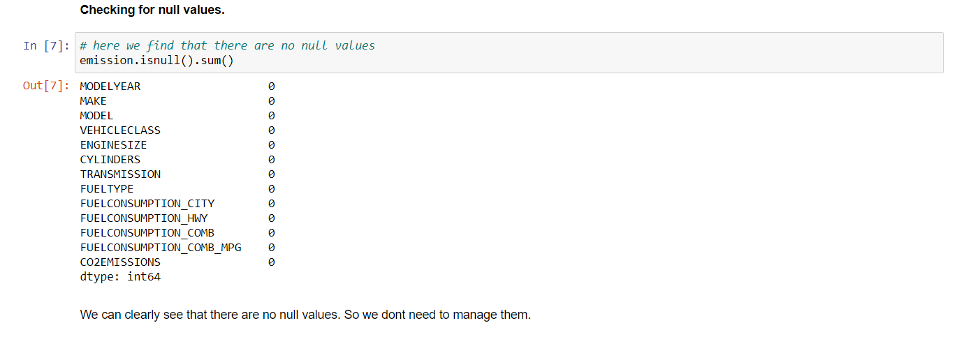

Slide 8
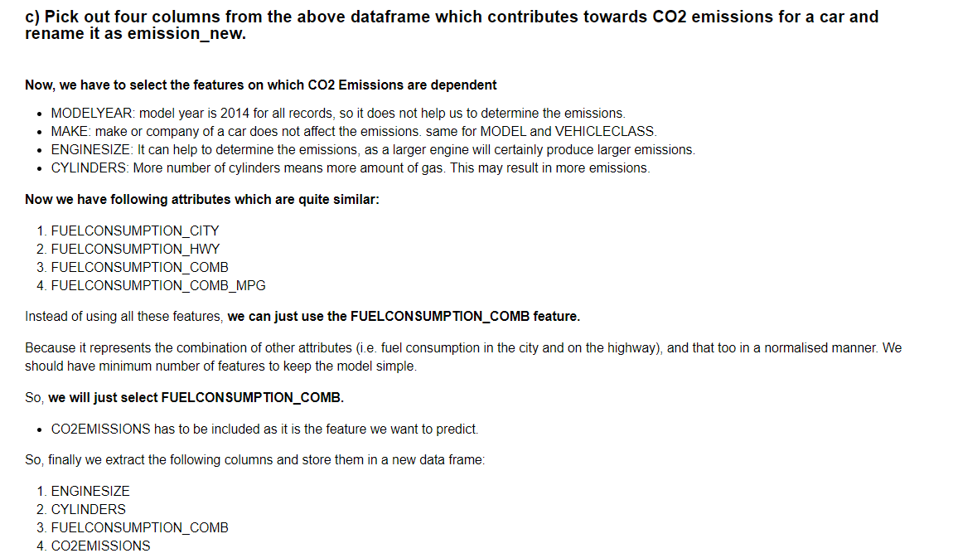

Slide 9
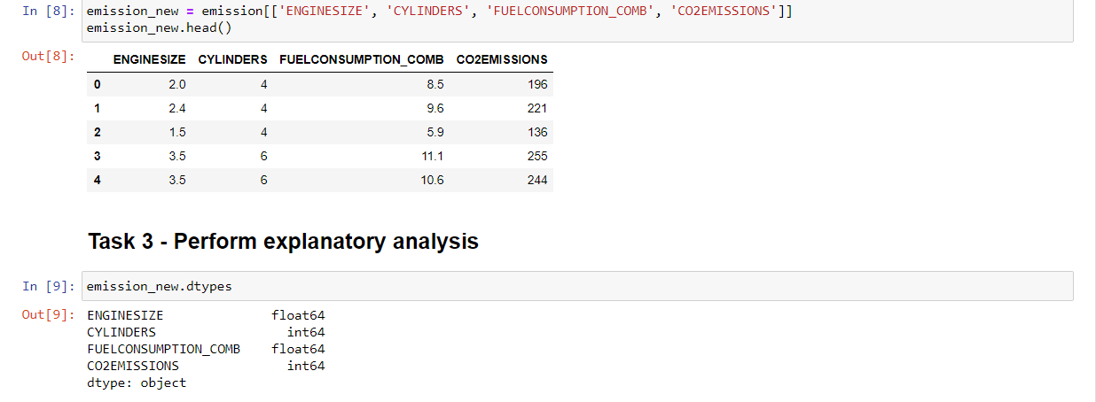

Slide 10
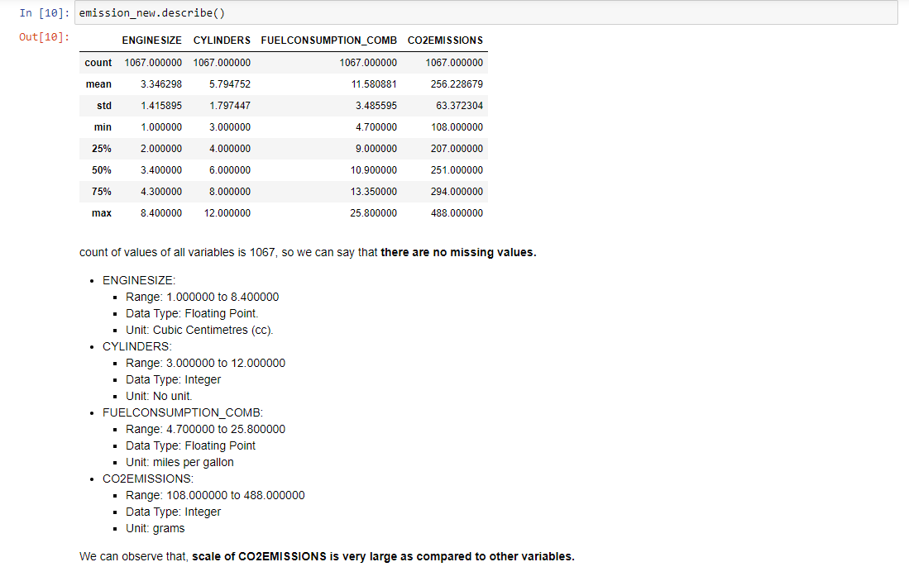

Slide 11
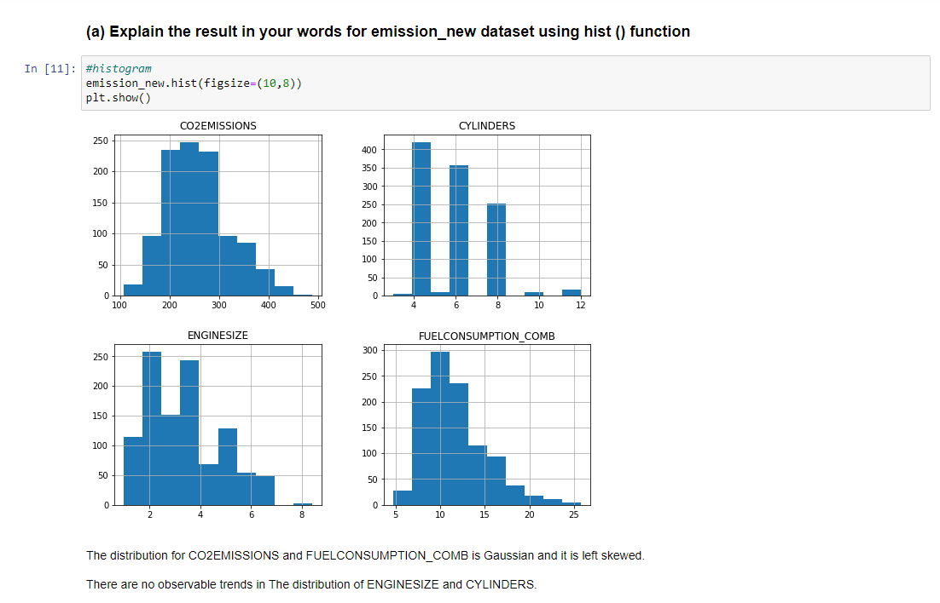
TASK 4- Visualising Data

Slide 12
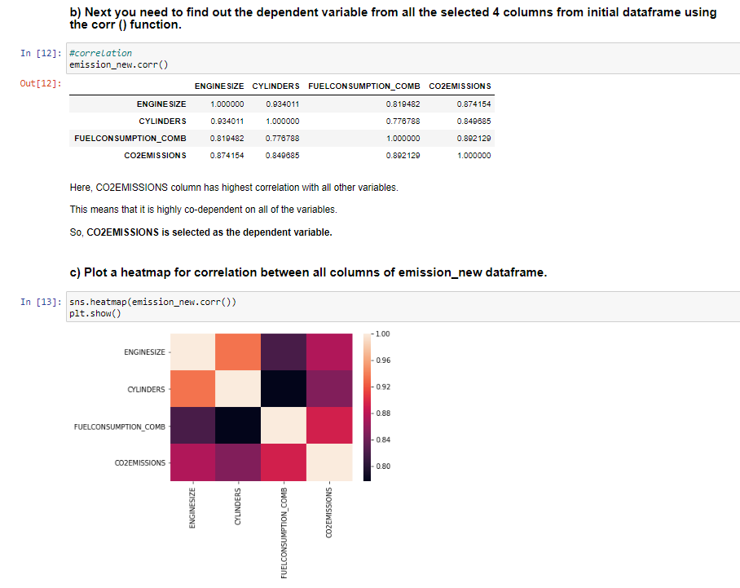

Slide 13
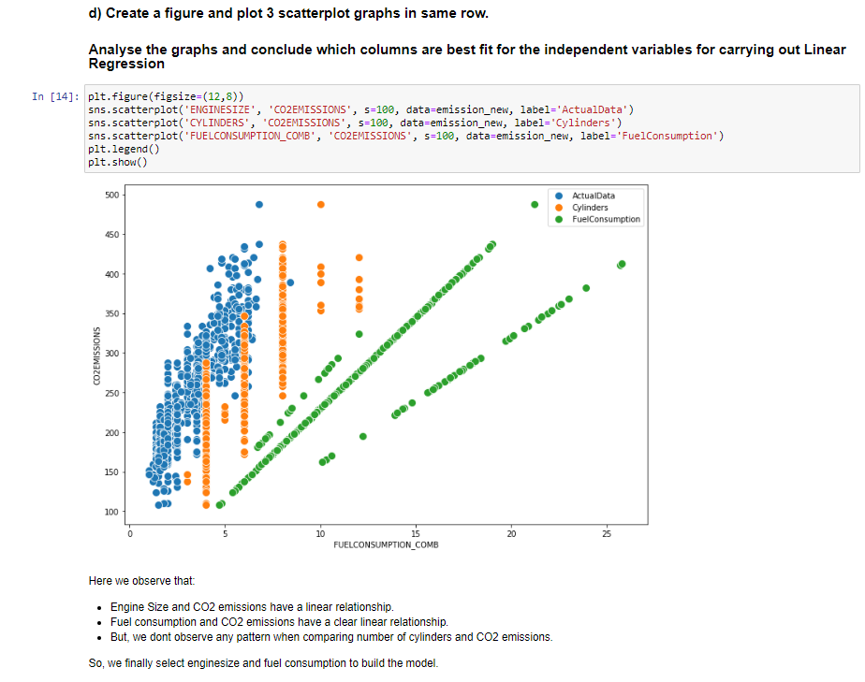

Slide 14
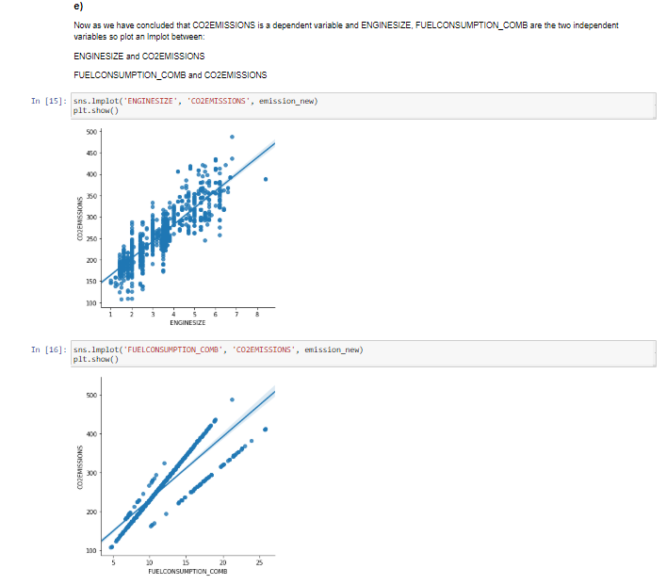

Slide 15
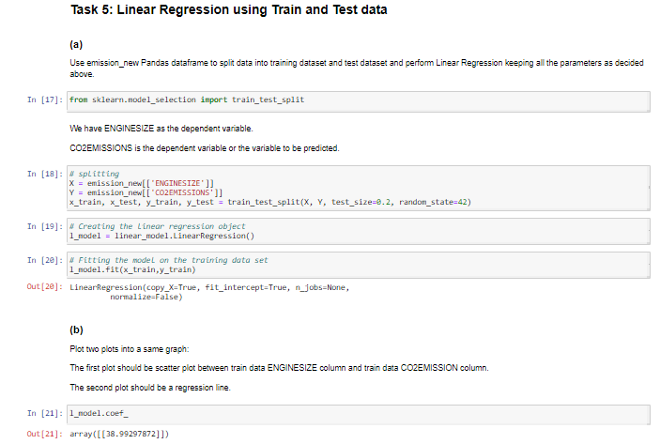

Slide 16
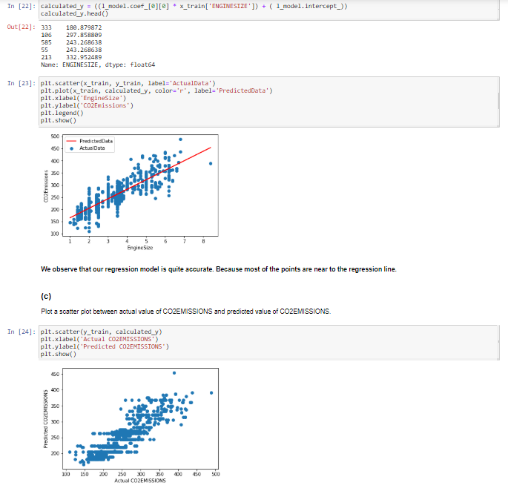

Slide 17
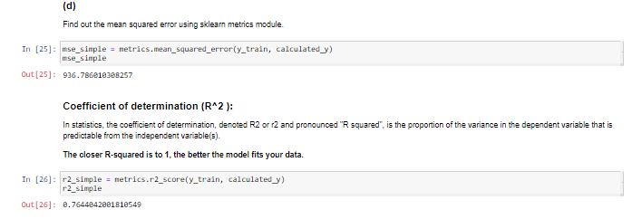

Slide 18
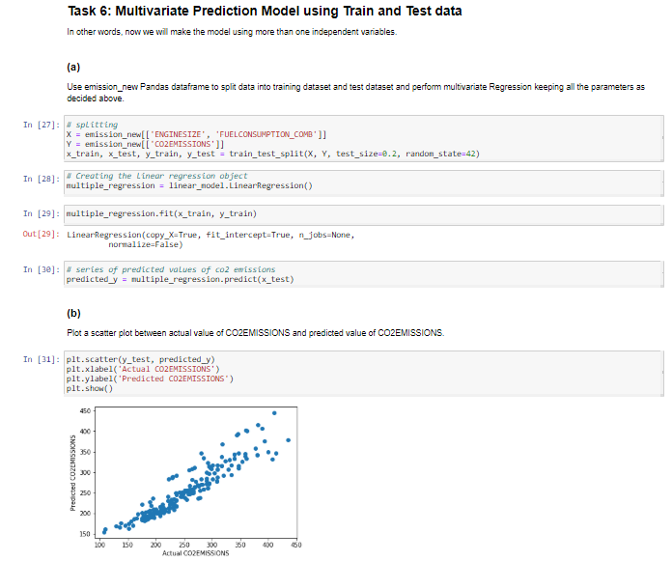

Slide 19
